Slide 1
Air Quality UPDATE Pinal county Air Quality permit compliance assistance seminar
Mike Sundblom
Director
Pinal County Air Quality Control
February 15, 2018

Slide 2
Pinal Regulatory Issues
PM-10 nonattainment
NAA Designation - July, 2012
SIP Complete (1/5/2016 Submittal)
ADEQ was the lead agency in SIP development (statutory)
MAG (Maricopa Association of Governments) will lead all SIP development in the future
Under EPA review – 18 months to approve or disapprove

Slide 4
SIP Identified PM10 Sources
Open areas, vacant lots, unpaved parking lots, construction operations, agricultural operations, animal feed operations, unpaved roads, road shoulders
Two conditions identified:
Stagnation/Low Wind – Activity driven emissions
High Wind – Unstable surfaces

Slide 5
SIP Control Measures
Agricultural Operations
Open Field Ag, Feed operations, Dairy operations, Irrigation Districts (AgBMP’s – ADEQ)
EPA Proposed SIP Approval 1/2017 (partial list)
Construction Activity
Effective locally 1/1/2016
EPA Proposed SIP Approval 1/2017
Fugitive Dust
Effective locally 1/1/2016
EPA Proposed SIP Approval 1/2017

Slide 6
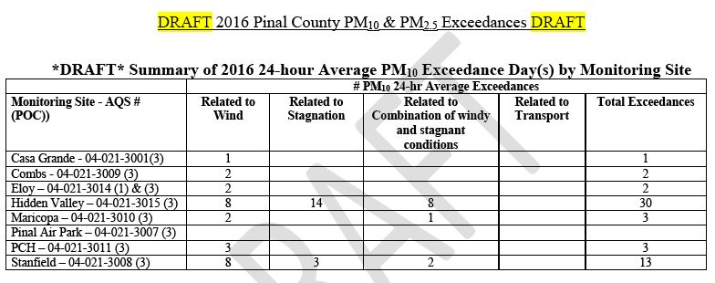
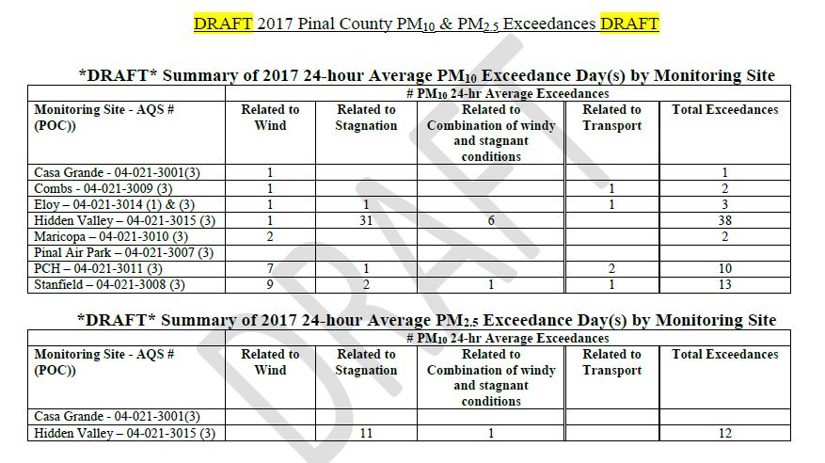
2016 PM10 Summary

Slide 7
Ozone NAAQS Revision
On October 1 2015 EPA Finalized a Revision to the 8-Hour Ozone Standard
Level set at 70ppb
3 year avg of 4th highest daily 8 hour conc.
Includes Both Primary and Secondary Standard
ADEQ proposed NAA Boundary October 2016
EPA missed deadline to finalize area designations in October late 2017
EPA issued prepublication designations in December including a portion of Pinal. Final Action March 2018.

Slide 8
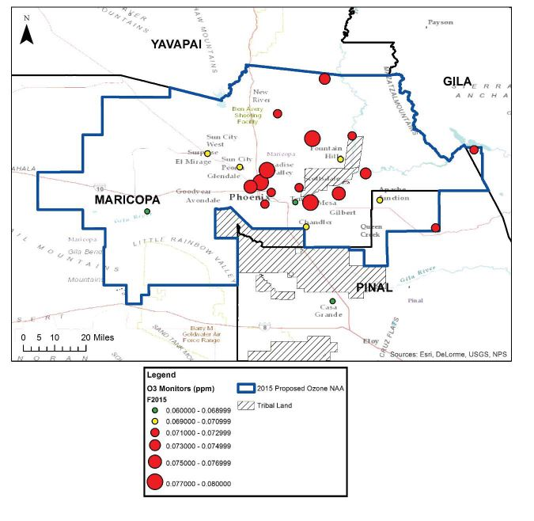

Slide 9
SIP Requirements

Slide 10
I-10 Picacho (MP214)
Historically a hot spot for dust related accidents
I-10 Workgroup formed in 2016 to study (PCAQCD, ADEQ, ADOT, NRCS, State Land, U of A, public participants)
Soil survey NRSC/PCAQCD
Resulted in 2 step approach:
Short Term Solution (stabilization)
Long Term Solution (contouring, vegetation, etc.)

Slide 12
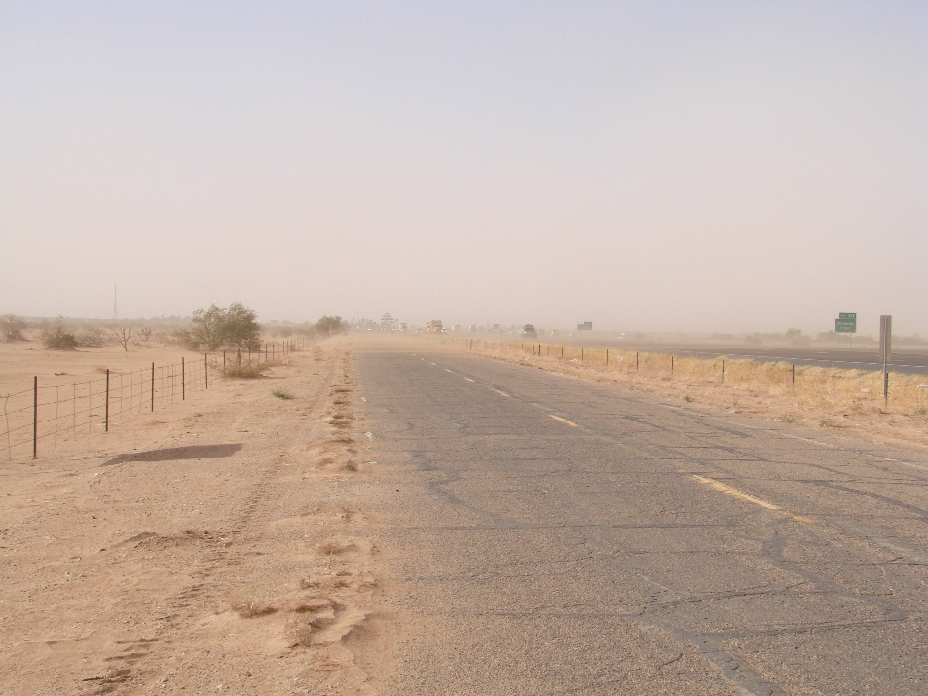
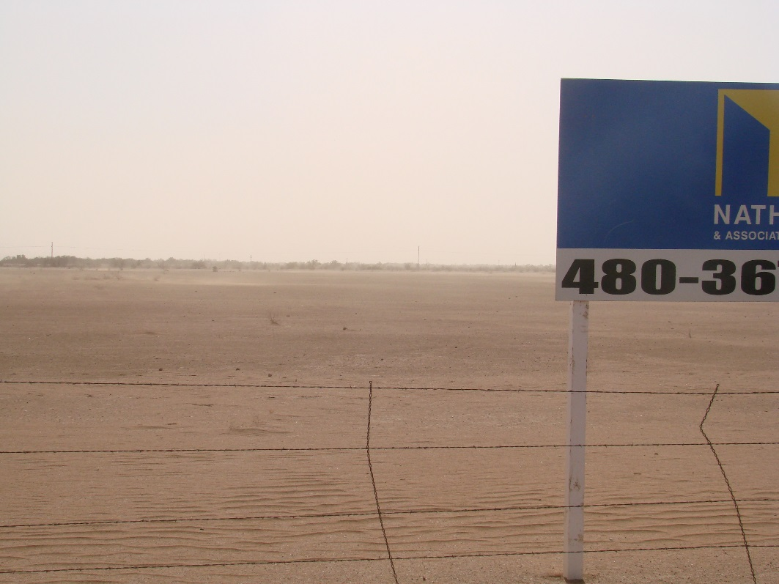
MP214 Pretreatment

Slide 13
MP 215 Short Term
Target was to stabilize surface
ADEQ stabilization contract
Treatment of 55 acres completed September 2017; 3 year application
Polymer product used
Post application monitoring with U of A to determine treatment longevity and soil influx (BSNE saltation monitors)

Slide 14
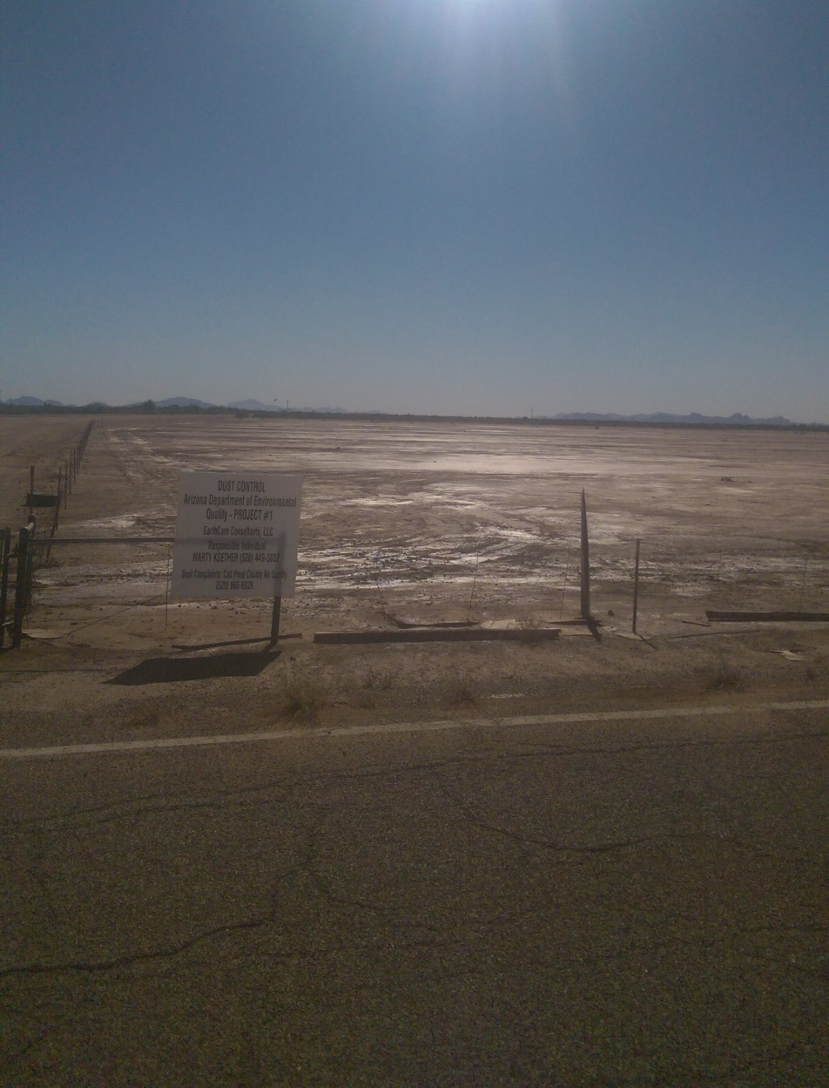
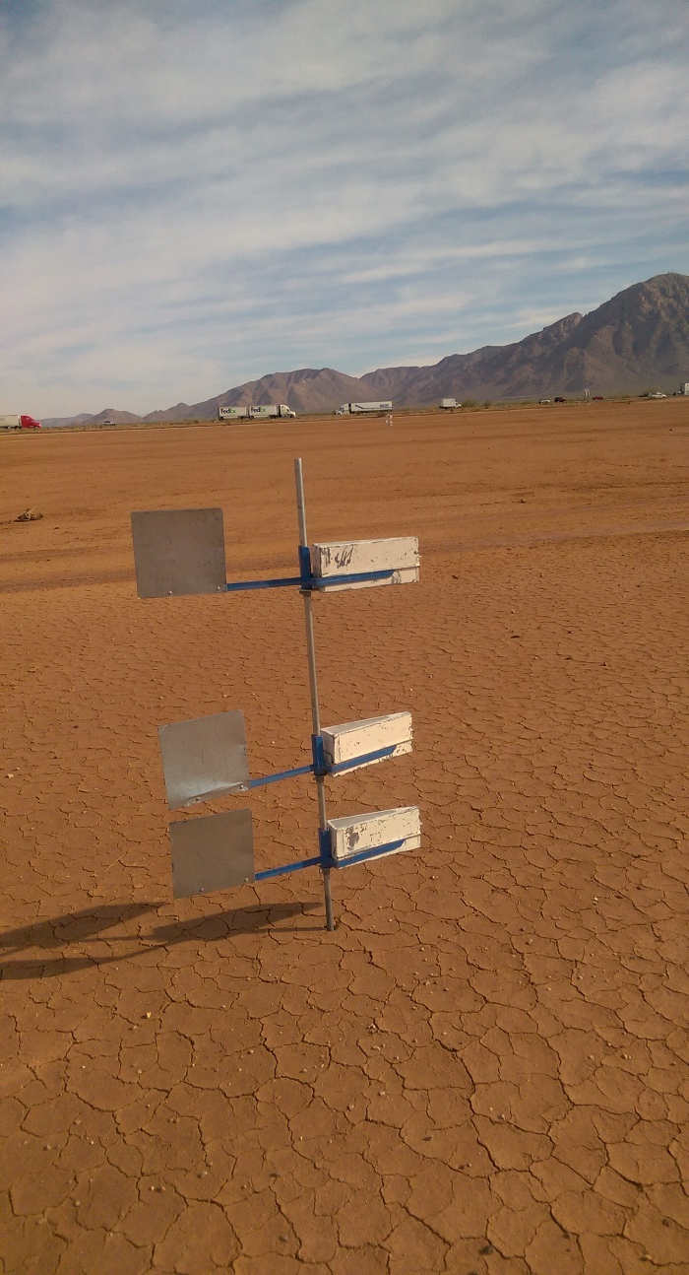
Post Treatment
Post Treatment
Monitoring

Slide 15
Contact Information
Mike Sundblom
Michael.Sundblom@pinalcountyaz.gov
(520)866-6915

